Slide 1
JavaScript - UFO hunter game Playing Field, Position & Spaceship

Slide 2


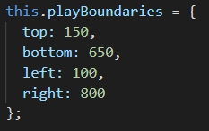
The active playing field
The active playing field within the canvas is delimited
900 px
0
700 px
top: 150
500 px
bottom:
650
750 px
left: 100
right: 800
Canvas

Slide 3
Position Container Array
push a position into the array
pop it from the array
empty the array
main
positionOpening
positionTransfer
positionInGame
positionPause
positionGameOver
Canvas

Slide 4
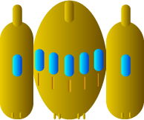
Spaceship image
width = 34 px
height = 28 px

Slide 5


Spaceship correct positioning
0
Y
Y
X
X

Slide 6

Moving our spaceship
0
width = 900 px
X
Y
X = play.width / 2 = 900 / 2 = 450
Y
>
this.spaceshipSpeed = 200
this.upSec = 0,01666667
200 * 0,01666667 = 3,34
X
X = 450 + 3,34 = 453,34

Slide 7
The active playing field
The active playing field within the canvas is delimited
900 px
0
700 px
top: 150
left: 100
500 px
bottom:
650
750 px
right: 800
Canvas

Slide 8
Spaceship correct positioning
0
Y
Y
X
X

